Slide 1
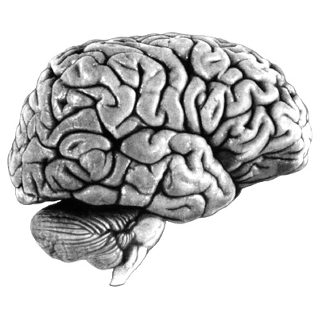
Why Brains Are Ugly

Slide 2
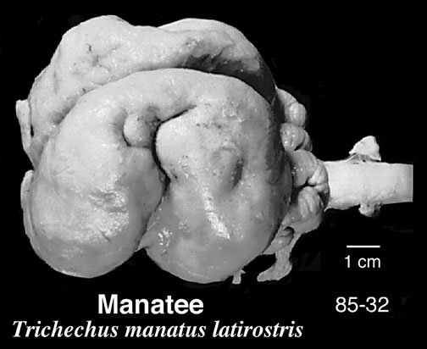
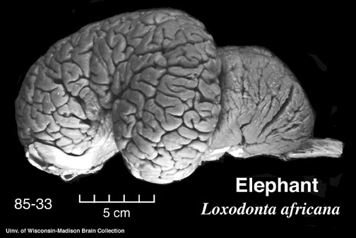
Let’s face it. . .
brains are ugly and complicated looking

Slide 3
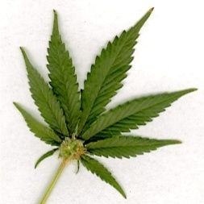
And we may be the worst offender!
F
P
F
O
T
The problem is that much of the ‘architecture’ of the brain is not functionally meaningful

Slide 4
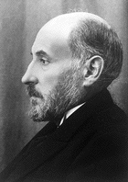
Santiago Ramon y Cajal
‘…to extend our understanding of neural function to the most complex human physiological and psychological activities, it is essential that we first generate a clear and accurate view of the structure of the relevant centers, and of the human brain itself, so that the basic plan – the overview – can be grasped in the blink of an eye.’
Histology of the Nervous System of Man and Vertebrates (1909)

Slide 5
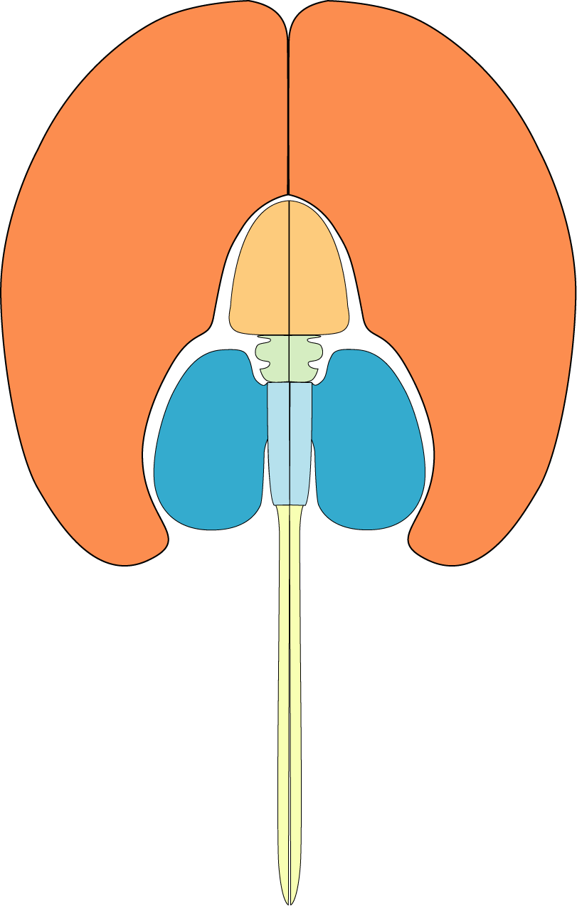
Telencephalon
(or ‘Cerebrum’)
Brainstem
To Begin, Let’s Break the Brain into Two Functional Parts.
Swanson, 1995

Slide 6
Telencephalon
Now add in some sub-divisions
Cortex
Limbic System
Basal Ganglia
Diencephalon
Thalamus
Hypothalamus
Midbrain
Superior Colliculus
Inferior Colliculus
Brainstem
Cerebellum
Brain Regions
You Should
KNOW
Hindbrain
Spinal Cord

Slide 7
Tel: 38
Di: 6
Mid: 4
Hind: 7
Cblm: 10
SC: 35
Tel: 81
Di: 4
Mid: 1
Hind: 2
Cblm: 10
SC: 2
Rat
CNS
81
Human
CNS
Swanson, 1995
Notes:
Here’s a pair of mammal brains. These are flatmaps where the area of each subdivision reflects its contribution to total brain weight. For example, notice the large orange cap on each brain – this region is called the telencephalon (you’ve probably heard of one of the telencephalon’s major components, ‘the cerebral cortex’). The rat brain is 38% telencephalon by weight whereas the human brain is 81% telencephalon by weight. In other words, both brains have the same basic components, but their relative proportions can be very different. Of course, the actual weights of these brains are also very different, but that relates more to the fact that we’re a lot bigger than rats are. See the last slide if you’re not sure what my abbreviations mean.

Slide 8
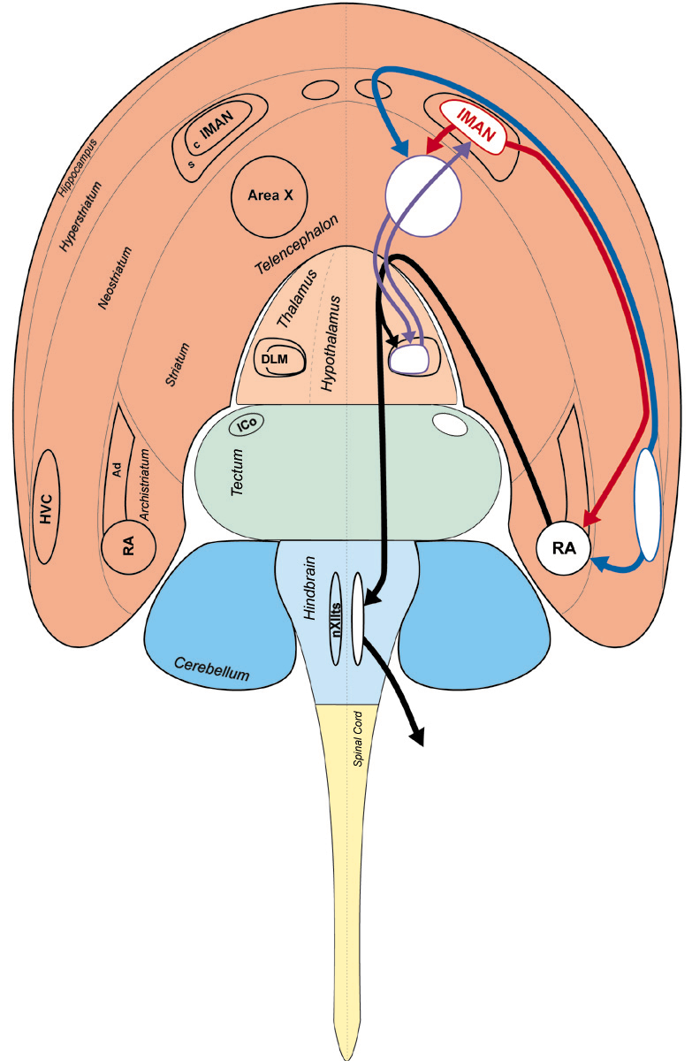
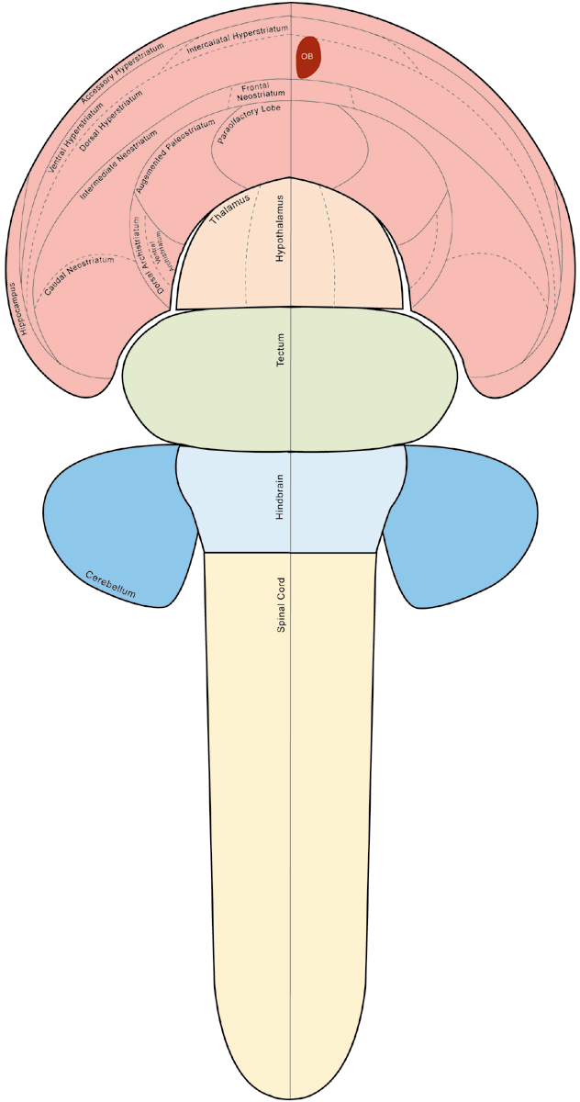
Tel: 64
Di: 6
Mid: 10
Hind: 6
Cblm: 10
SC: 4
Tel: 38
Di: 6
Mid: 12
Hind: 7
Cblm: 11
SC: 26
Zebra Finch
CNS
64
Pigeon
CNS
Notes:
Here’s a pair of bird brains.

Slide 9
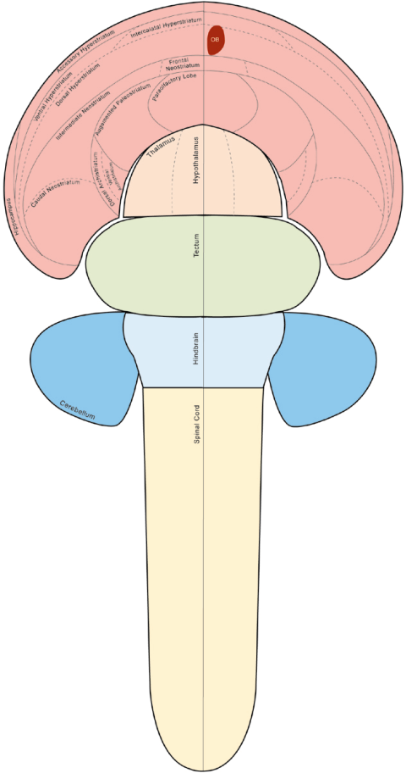

Rat Pigeon Finch Human
Telencephalon: 38 38 64 81
Diencephalon: 6 6 6 4
Midbrain: 4 12 10 1
Hindbrain: 7 7 6 2
Cerebellum: 10 11 10 10
Spinal Cord: 35 26 4 2
Notes:
Hey kids, collect all four!
Question to ponder – What are some obvious behavioral differences between mammals and birds? How does this relate to brain organization?

Slide 10

The Brainstem has a simple dorsal/ventral organization
Dorsal
Ventral
When they are sick,
Some Dogs
Might Vomit
Thalamus
S e n s o r y – D o r s a l
Hypothalamus
M o t o r – V e n t r a l
Note the two sub-divisions of the diencephalon: Thalamus and Hypothalamus

Slide 11
Telencephalon
Stimulus (what), motor control
Primary
Motor Cortex
Thalamus
relay, feedback
(except olfaction)
Primary
Sensory Cortex
Midbrain
Stimulus (where) vision and audition only and orienting responses
GENERAL Overview of Sensory System Organization
Spinal Cord
reflexes, input, output
Rat
CNS
Motor output
Sensory input
(L/R and R/L crossing for vision, touch, audition only)

Slide 12
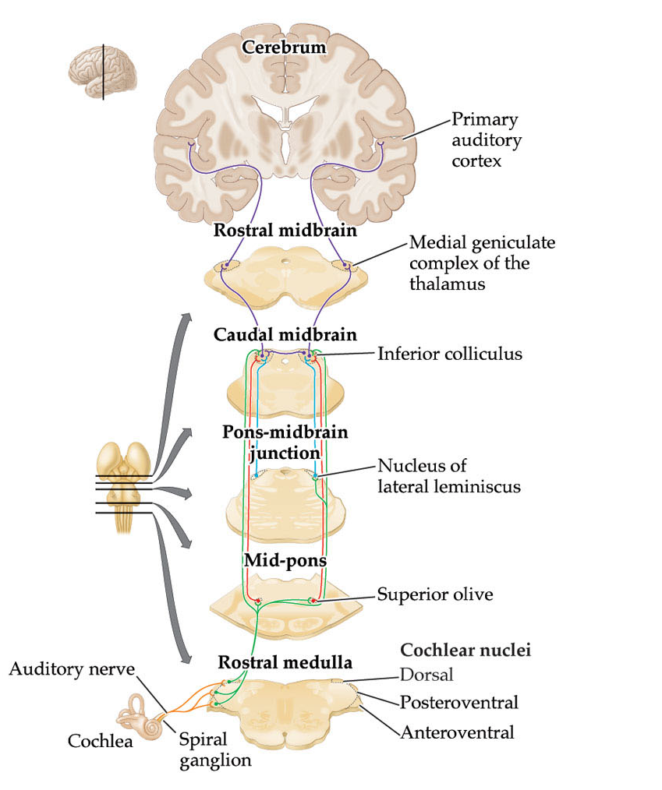
Telencephalon
Primary Auditory Cortex
Thalamus
Medial Geniculate
Midbrain
Inferior Colliculus
Hindbrain
Pons, Medulla
Rat
CNS

Slide 13
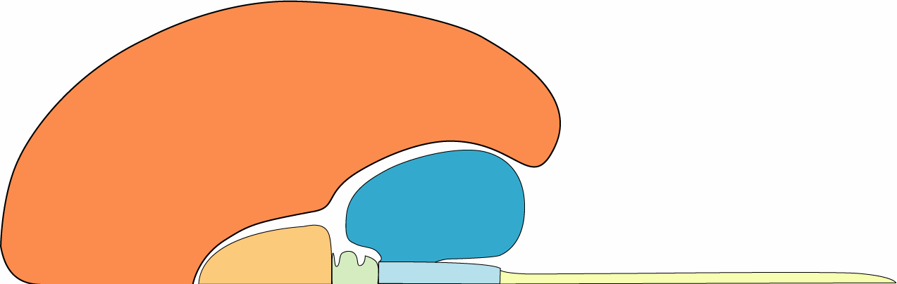
Telencephalon
TELENCEPHALON
AND
DIENCEPHALON
(some key subregions for S&P)
Cortex
Limbic
Basal Ganglia
Cortex
Hippocampus
Diencephalon
Amygdala
Thalamus
Basal
Ganglia
Hypothalamus
Thalamus
Hypothalamus

Slide 14
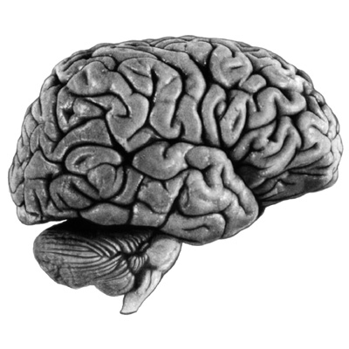
CORTEX is made of Vertical Columns, each containing 6 layers of neurons
1
2
3
From Thalamus
4
Back To Thalamus
5
6
Output Layer

Slide 15
Primary Cortex
Thalamus
2D Receptor
Array
However…

Slide 16
Cortex Is
‘Modular’
Means the size and density of cortical columns is fixed
Thalamus
Dense 2D
Receptor Array

Slide 17
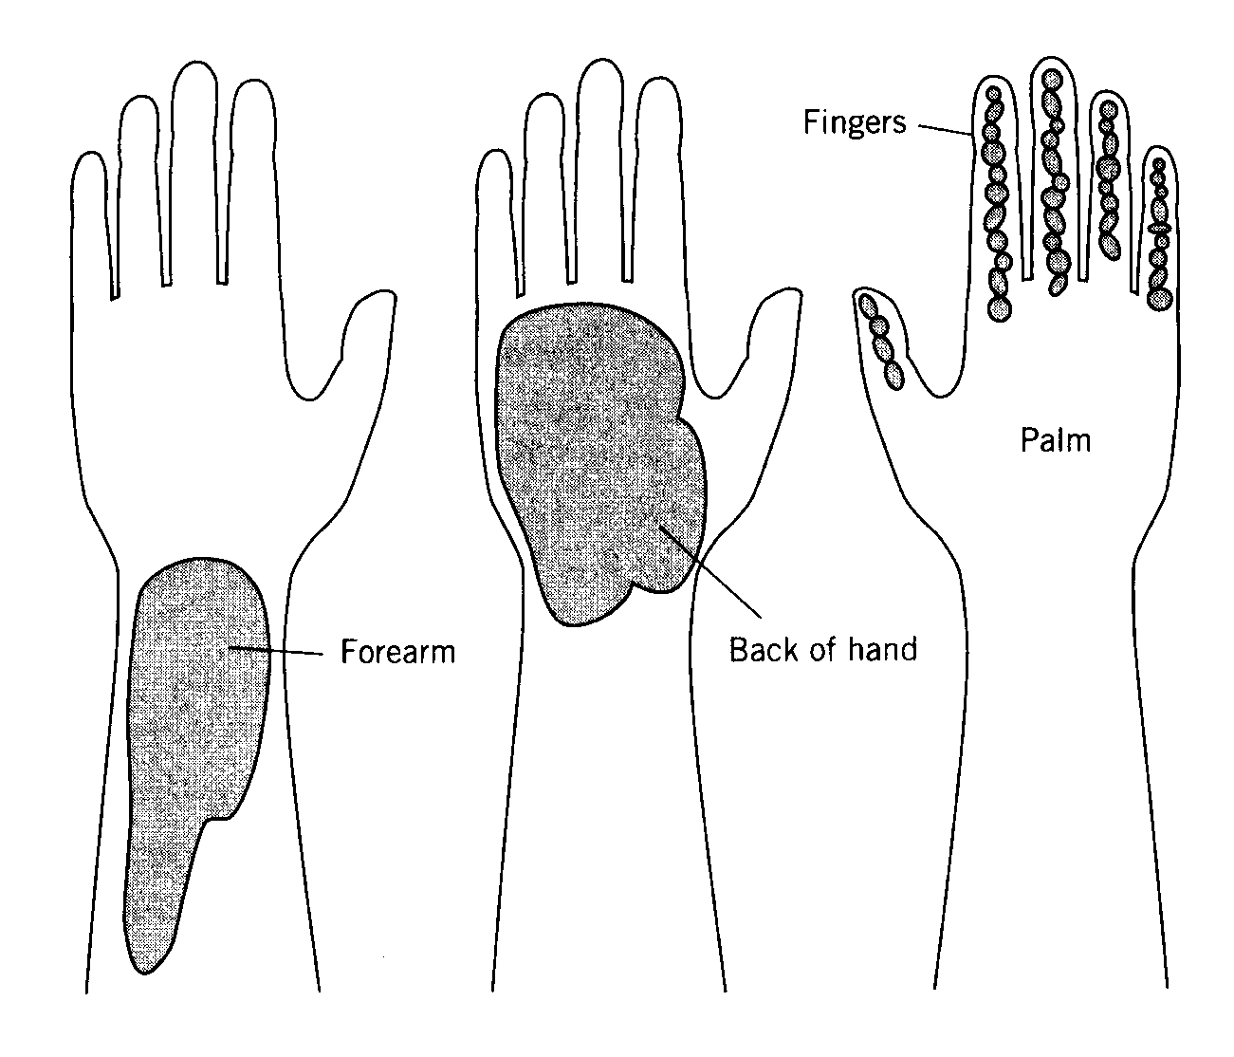
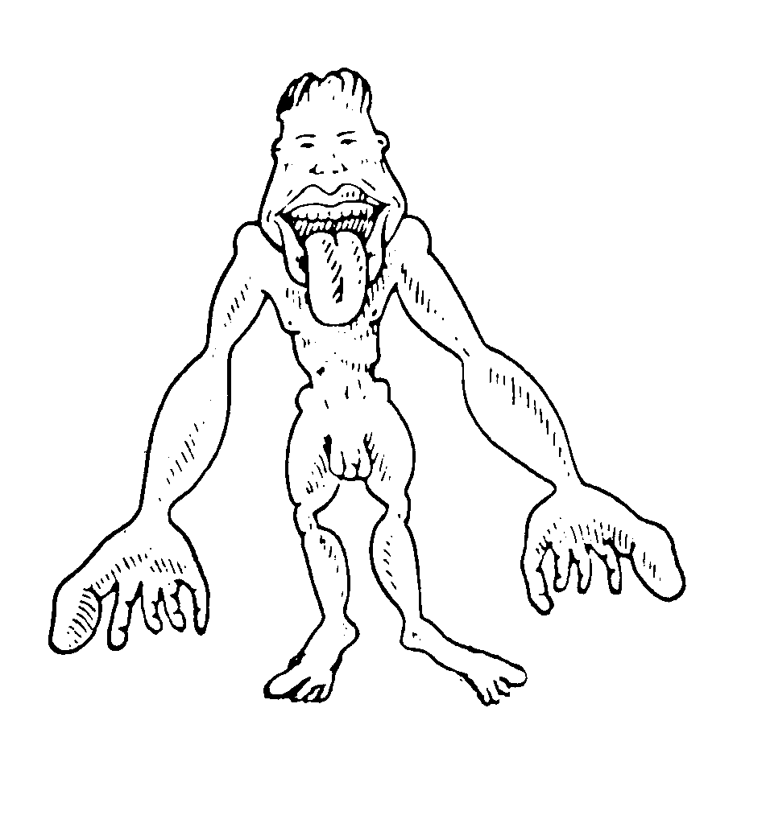
Because Cortex is Modular, Sensory ‘Maps’ in Primary Cortex are Distorted by Variation in the Density of Sensory Receptors

Slide 18
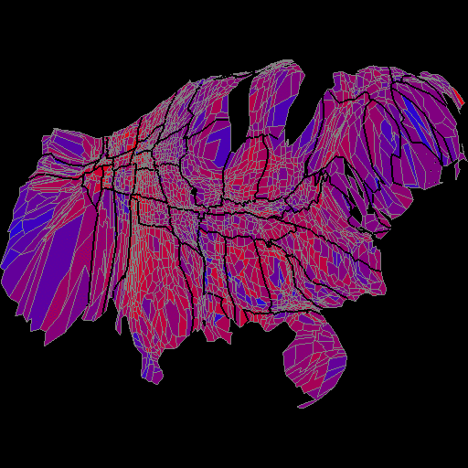
A ‘homunculus’ of the USA
Ha-ha! That looks funny!

